Slide 1














PLAYER 1
HIGHSCORE 2500
PLAYER 2
AVERAGE BASE SALARY PREDICTION
The Salary Crystal Ball

Slide 2
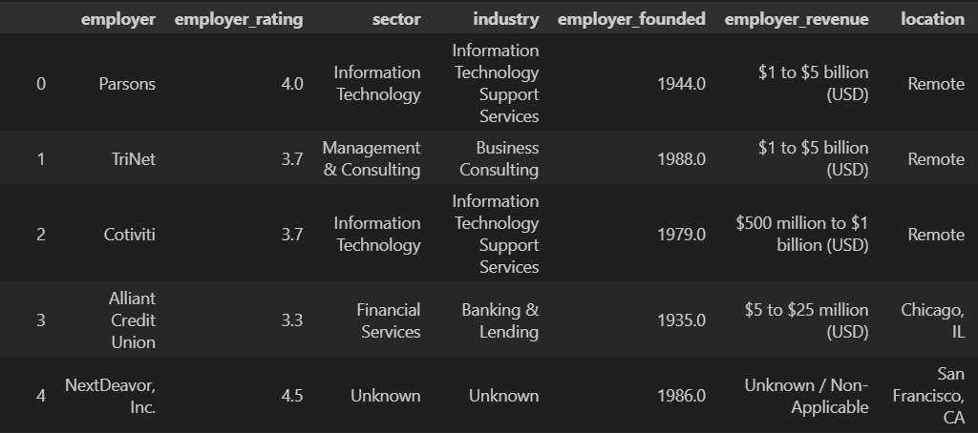
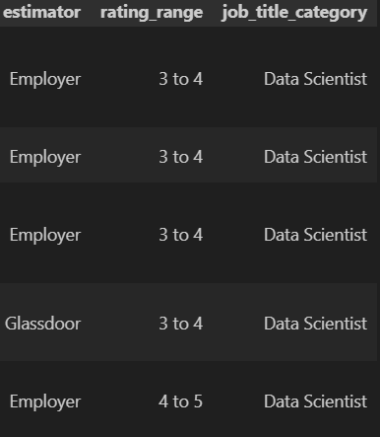
HERE’S WHAT THE DATAFRAME LOOKS LIKE

Slide 3
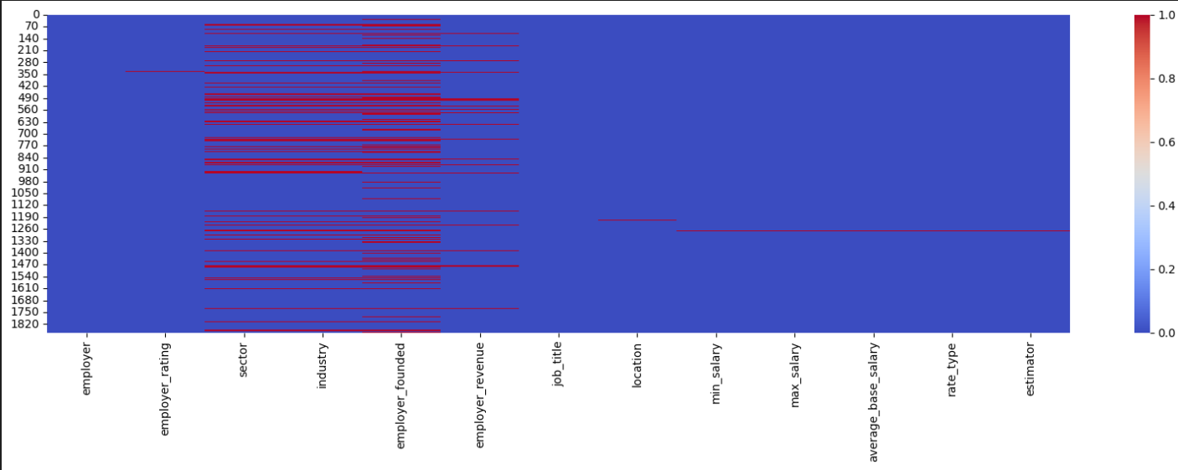
MISSING VALUES VISUALIZATION

Slide 4




THE DATASET ITSELF
METRICS CHOSEN: MAE AND MAPE
FEATURES
employer (company name)
employer rating (0 to 5)
sector
industry
employer_founded
employer_revenue
location
estimator
rating range
job_title_category
1871 ROWS
TRAINING SET - 80%, TEST SET - 20%, VALIDATION SET - 20% OF THE TRAINING SET
LOSS 0

Slide 5
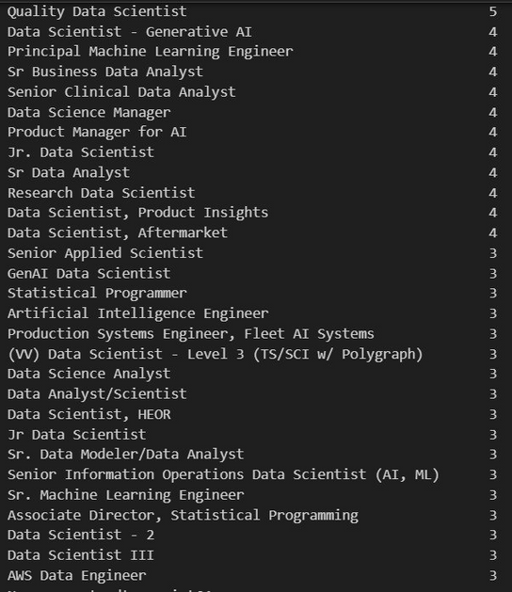
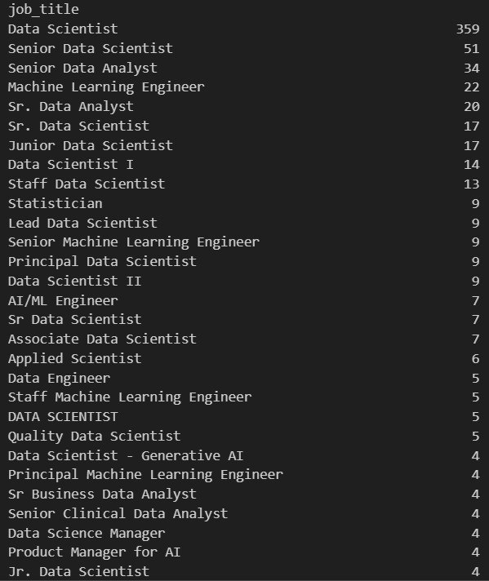
SOME DS JOBS
We added a feature ‘job_title_category’ to deal with so much...diversity
BEFORE....
btw it’s only top-50 unique job titles
(there were much more of them)
...AFTER

Slide 6
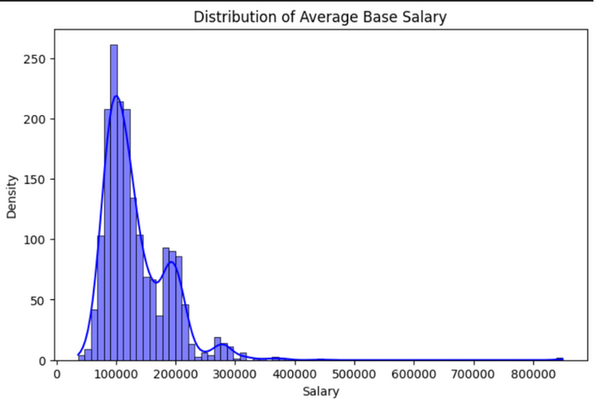
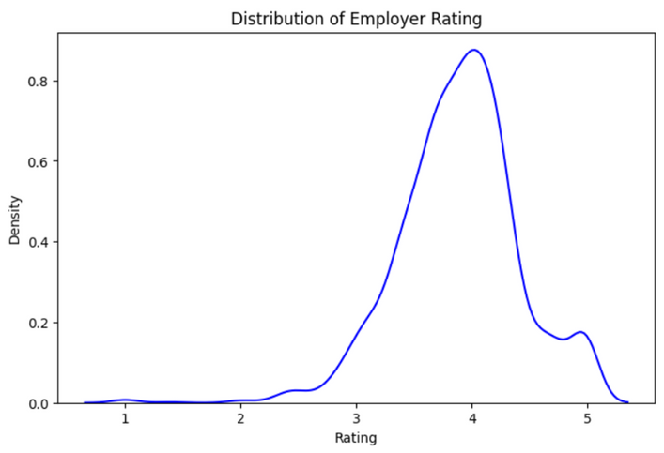
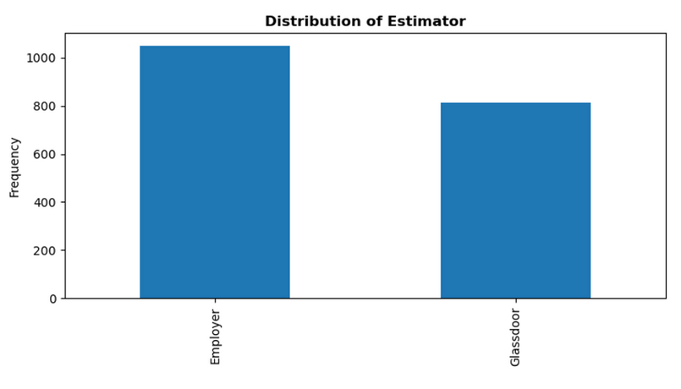
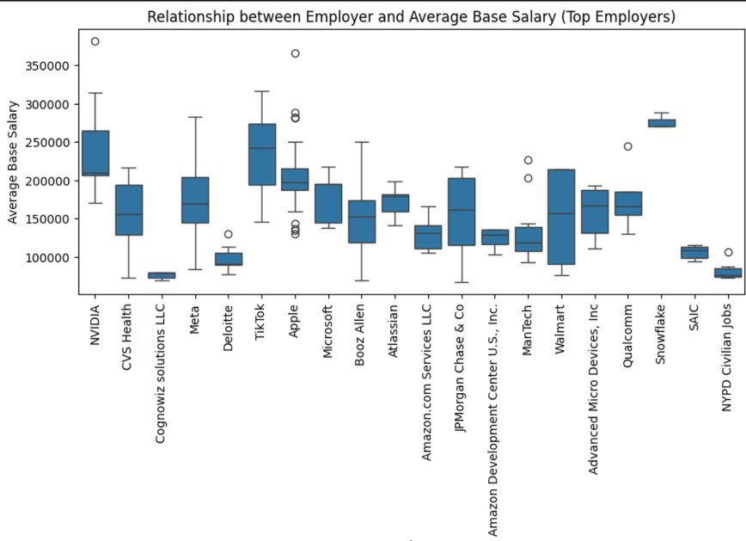
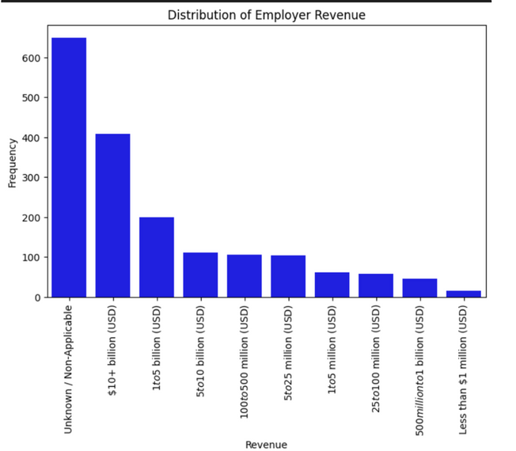
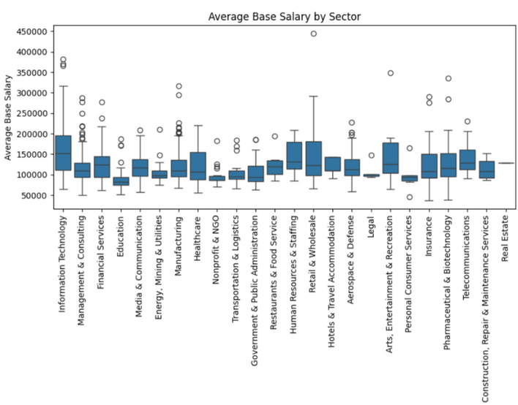
EDA #1

Slide 7
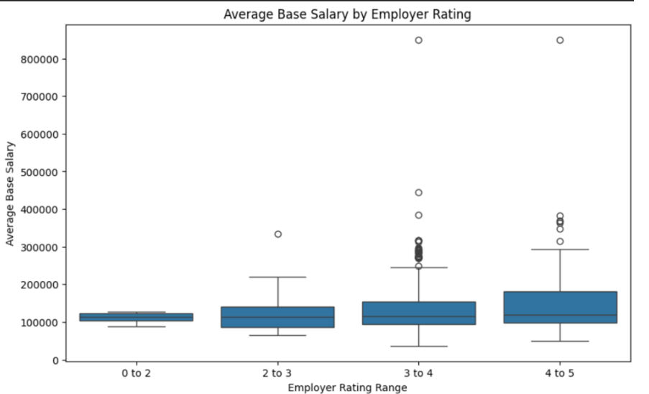
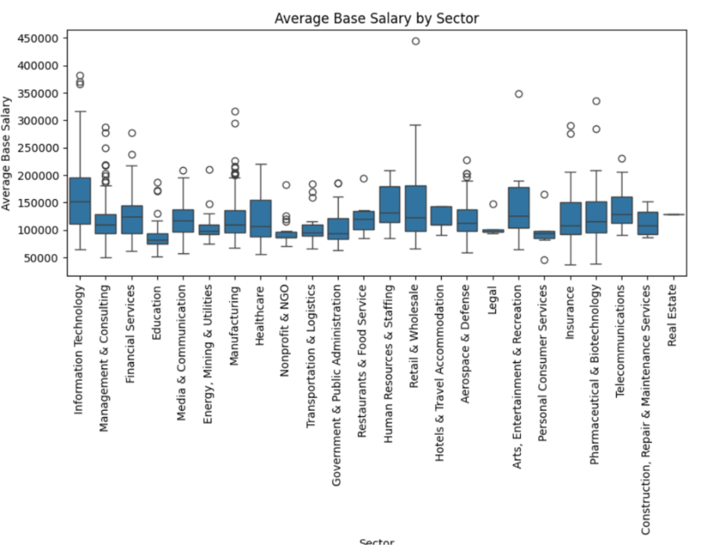
EDA #2

Slide 8
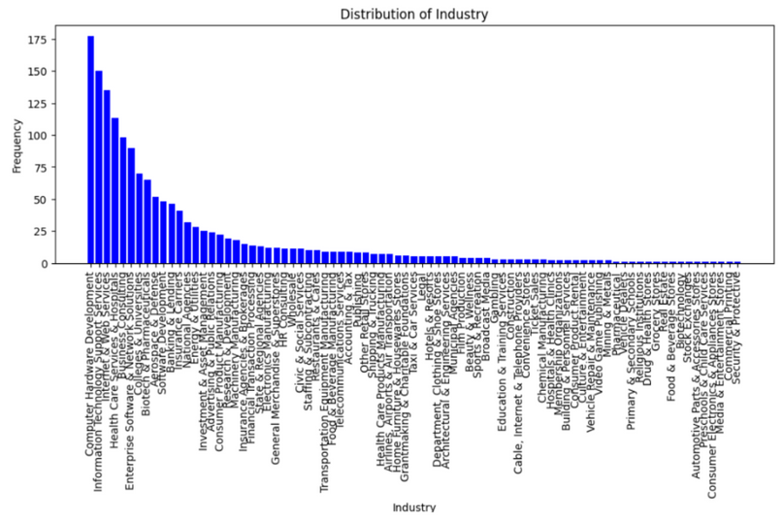
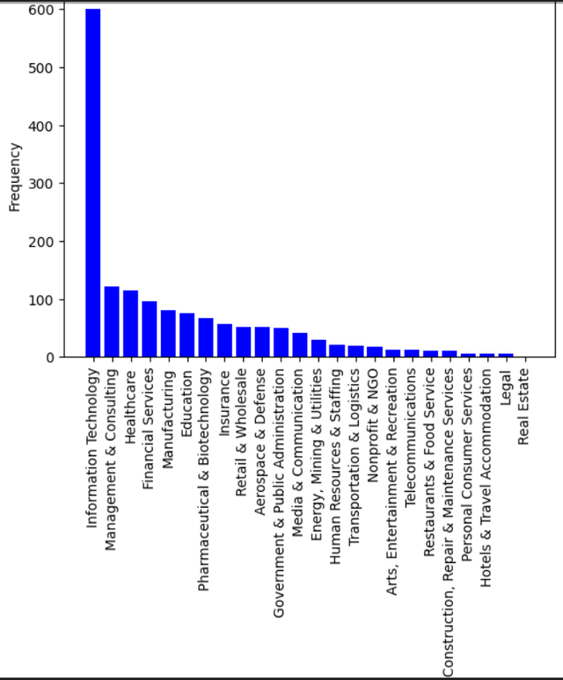
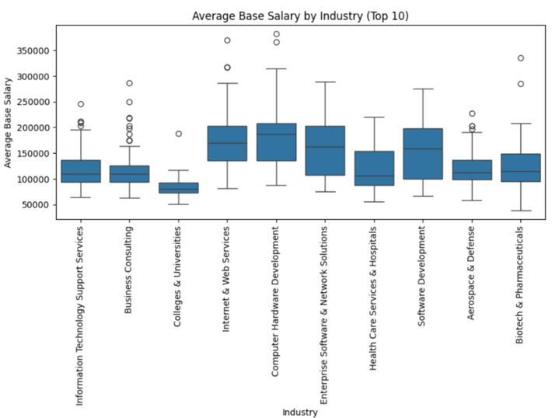
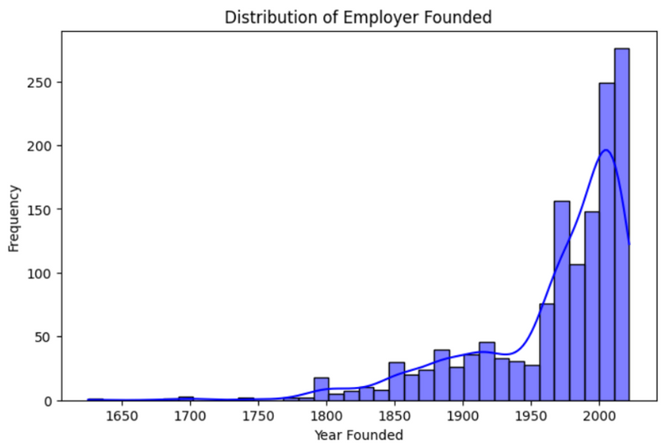
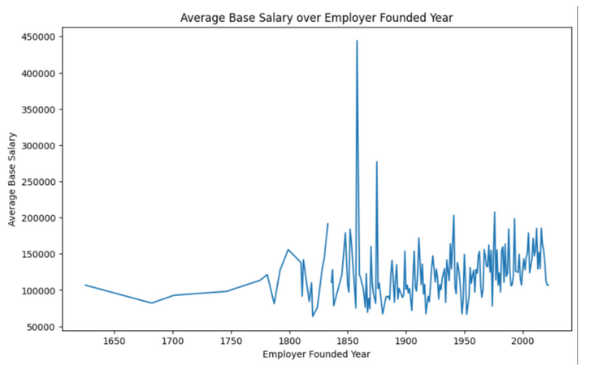
EDA #3

Slide 9
SOME STUFF WE NOTICED ABOUT THE JOBS
TOP-3 MOST POPULAR SECTORS: INFORMATION TECHNOLOGY, MANAGEMENT AND CONSULTING, HEALTHCARE
TOP-3 MOST POPULAR EMPLOYERS: APPLE, META, MICROSOFT
THE OLDEST COMPANY HIRING IS 399 YEARS OLD
TOP-3 LOCATIONS BY FREQUENCY: NEW YORK, SAN FRANCISCO, WASHINGTON.
HOWEVER, REMOTE WORK IS EVEN MORE POPULAR.
THE AVERAGE EMPLOYER RATING IS 3.8 (NOT SO BAD)
THE SMALLEST SALARY: 34560
THE LARGEST: 900000

Slide 10


MODEL RESULTS
aka the wall of shame
MODEL NAME | TEST SET | VALIDATION SET
LINEAR REGRESSION | MAE: 33720 MAPE: 0.2854 | MAE: 35920 MAPE: 0.2969
PARTIAL LEAST SQUARES REGRESSION | MAE: 31342 | MAE: 32274
SVR | MAE: 31342 | MAE: 37950
RANDOM FOREST | MAE: 27180 MAPE: 0.2265 | MAE: 29083 MAPE: 0.2356
LGBM | MAE: 26270 | MAE: 28084
XGBOOST | MAE: 28027 MAPE: 0.2281 | MAE: 30162 MAPE: 0.2425
If you always predict the mean salary, MAE is 40425

Slide 11
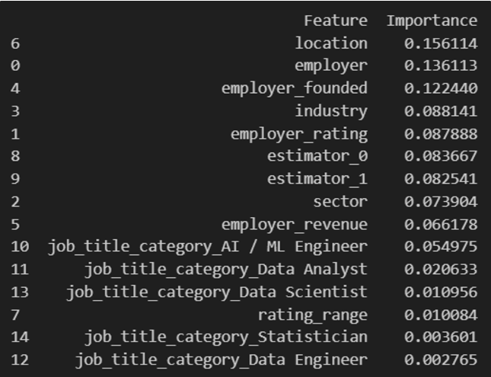
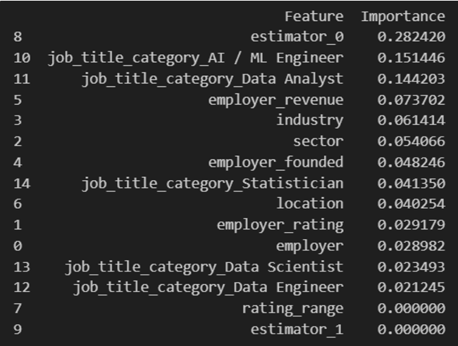
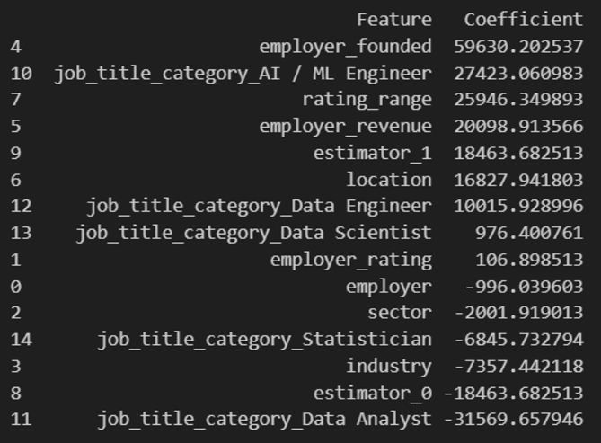
FEATURE IMPORTANCE
RANDOM FOREST
XGBOOST
LINEAR REGRESSION

Slide 12
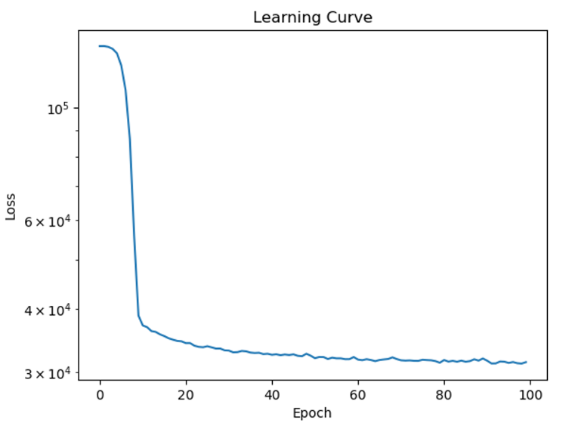


NEURAL NETS
SmoothL1Loss
n_epoch = 100, lr= 0.001, batch_size=32, 4fc (neurons 128,64,32,1),Relu
Validation: MAE: 35137.5334, MAPE: 0.2796 Test: MAE: 32844.1029, MAPE: 0.2681

Slide 13








THANK YOU!

